Slide 1
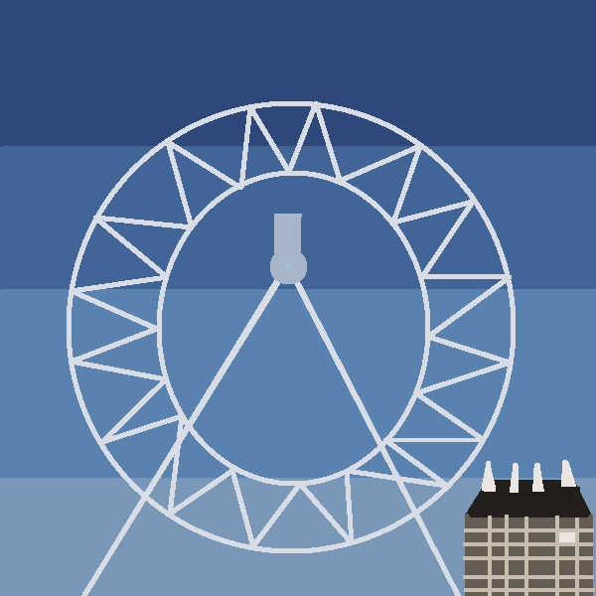
The London Eye
Gabas Yagoub 4-202

Slide 2
What is the purpose of the London Eye
To provide rides for people
Passengers can walk freely in side
Each stall is in touch with the ground and good seating exists

Slide 3
Why is it called the London Eye
Has eye shaped dome pods
Every stall is fully enclosed and comfortable
It is rotated at least 37,500 times

Slide 4
What is the purpose of the London Eye
Passengers can walk freely inside
Each stall is in touch with the ground
To provide rides for peope

