Slide 1
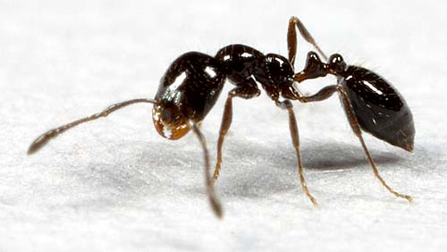
Black ants!
Class 2-105
By: Teresa Juarez

Slide 2
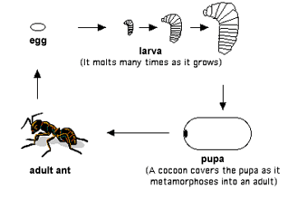
Life Cycle of Ants.
Ants are made up of three parts. The parts are head, thorax, and the abdomen.
The life of an ant starts as an egg. Then it turns into a larva. After, it turns into a pupa. Last, it turns into an adult ant.

Slide 3
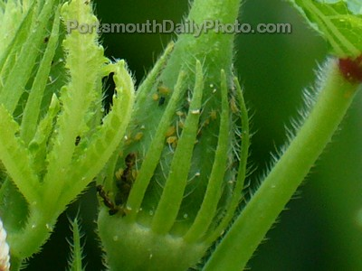
What do ants eat?
.
Ants EA
Ants eat dead animals and watermelons, fruits , grass., insects, sweet things, and sweet things.

Slide 4
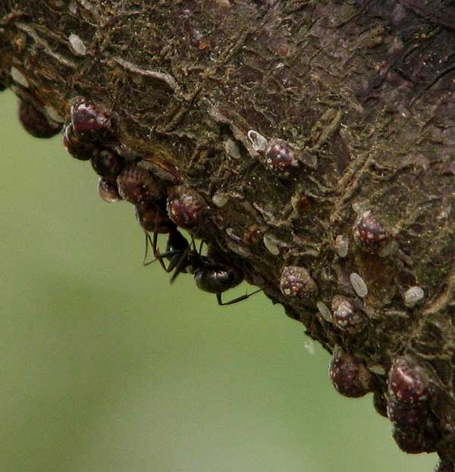
Where do ants live?
Ants live in wood, dirt, in plants, acorns, twigs, and galls.

Slide 5
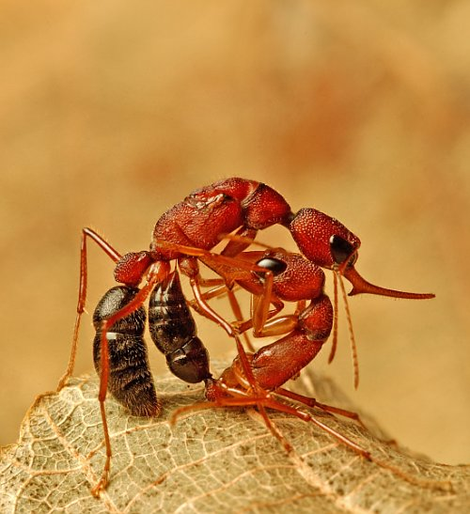
How do ants protect themselves?
Ants protect them self by rolling into a ball and moving slowly.

Slide 6
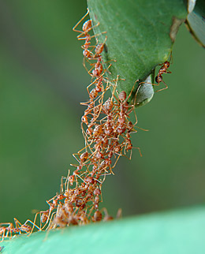
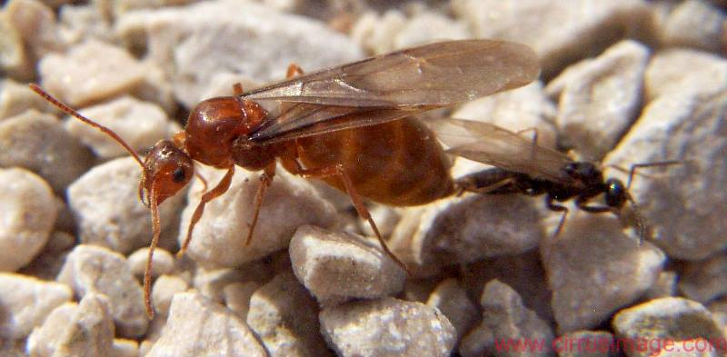
Interesting facts about black ants.
Ants are mostly found in hot climates. Over 1,000 years known species of ants exist in the world.
The ants live up to 45 to 60 days. Ants have 2 stomachs. Queen ants are provided with wings at birth.

