Slide 1
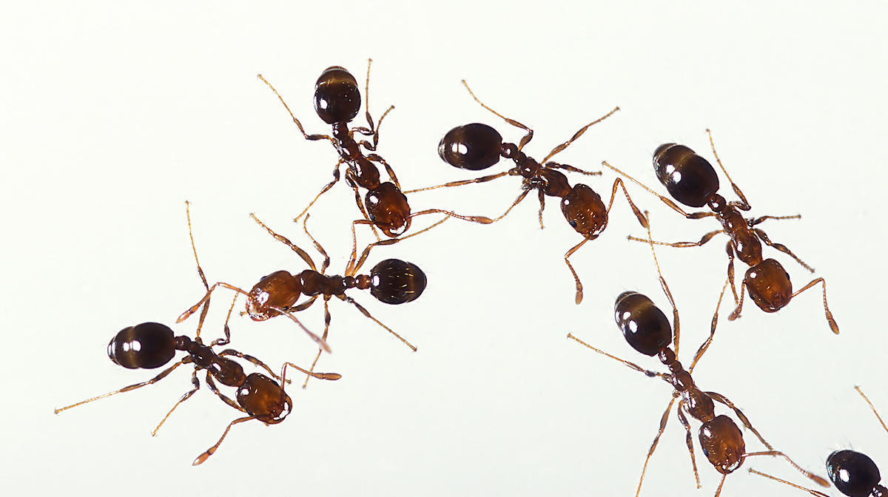
Ants
By Delani

Slide 2
What are Ants life cycle? Ants are brown. They are extremely small. Ants are made up of three body parts: head, thorax, abdomen. The ant starts out as an egg. It turns into larva. After, it turns into a pupa. Last it turns in an adult ant.

Slide 3
What does Ants Eat
Ants eat almost anything. They will eat most fruits, vegetables and plants they can find. They often eat smaller ants (of different species) and eat the meat off of dead insects and other small creatures..
Notes:
t

Slide 4
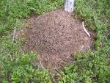
Where do ants live?
Ants live underground in the dirt. Their homes are called nests. They dig their nests with their legs. They use their antennae to feel around where they are going. Some ant nests can be 15 feet deep! Ants are hard workers and are very strong. On the top of the ground the nest looks like a hill of dirt. Some of these hills called ant mounds are very large. Under ground there are many tunnels and chambers (rooms.)
Ants live in Colonies, which have about 100 ants or more in one colony. Each ant has it's own job to do. There are worker ants and one queen ant. They workers do all the work and the queen only has babies. The queen is the very large ant on the left.

Slide 5
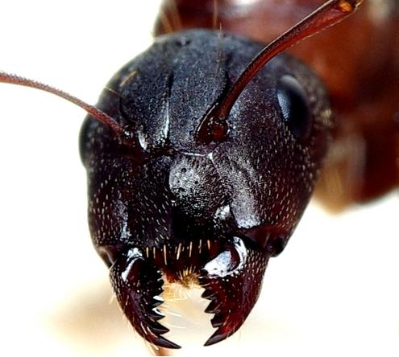
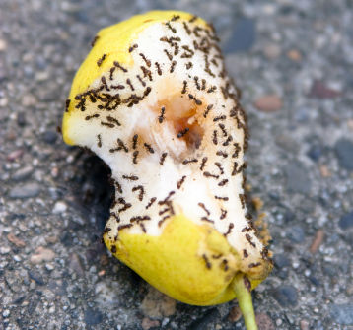
How do ants protect them self?
Ants defend themselves by biting the enemies with their sharp jaws. Insects can protect themselves in many ways. Here are some examples. They can fly away: flies, ladybugs They can hop away: crickets. grasshoppers They can use camouflage to blend in with their surrounding: moths, grasshoppers They can use their small size : they hide in small places their enemies can't go: ants They can adapt: They can live in cold places or extremely hot places where they have few natural enemies; The midgefly and woolly caterpillar can survive in Antarctica. They can bite and sting: earwigs, wasps and bees. They can eat certain plants: The monarch butterfly eats milkweed as a caterpillar so the adult butterfly will taste bad to birds.

Slide 6
Interesting facts about ants
Ants come from the Form ici dae family along with bees and wasps. Ants are known to be the smartest species of insects with about 250,000 brain cells and have an average life span of 45-60 days. They are also known to run very fast using their three jointed extremely strong legs.

